Slide 1
Advanced Operating System(CSc-538)
Dr. Binod Kumar Adhikari
Asst. Prof., CDCSIT TU

Slide 2
Objectives of the course
Introduce the underlying principles of an operating system, virtual memory and resource management concepts.
Explore current state‐of‐art research in operating system
Exposure real‐time systems
of distributed operating
system,
operating system and multimedia

Slide 3
Text Books and Materials
Text Books:
Silberschatz, A. and P. B. Galvin, Operating System Concepts, Sixth Edition, John-Wiley. (not Java edition)
Tanenbaum, A. S., Modern Operating Systems, Second Edition, PHI.
References :
Research and Technical Papers
Stallings, W., Operating Systems, Fourth Edition, Pearson.
Deitel H. M., Operating Systems, Second Edition, Addition Wesley.
Tanenbaum, A. S. and Woodhull, A. S., Operating Systems Design
and Implementation, Second Edition, PHI.

Slide 4
Tentative Course Plan
Process Management and Synchronization 12hrs
Process Model and communication, Process Scheduling, Deadlock
Research Paper Presentation( By Group of students).
Memory Management 13hrs
(Virtual Memory Management: Paging and Segmentation,
Storage/free space Management)
Research Paper Presentation(By Group of Students)
Protection and Security 8hrs
System Protection and Security Principles and Algorithms
Research Paper Presentation(By Group of Students)
Special Purpose Systems 12hrs
Distributed System, Real time System, Multimedia System
Research Paper Presentations

Slide 5
Evaluations
Internal Assessment: 30 marks
First Term Exam
Pre-Board Exam
Research Paper Presentations
Attendance (80% compulsory)
Semester Exam: 45 marks
End Semester Exam conducted by IOST, TU

Slide 6
Unit 1.1
Introduction to Operating System(OS)
Reading: Chapter 1 of Textbook

Slide 7
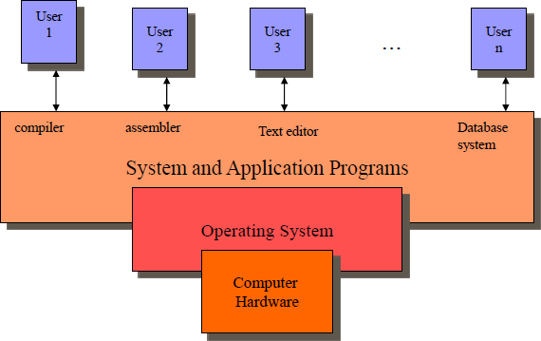
Where does OS sits?

Slide 8
Unit1.1 What is Operating System(OS)?
An OS is a program that acts an intermediary between the user of a computer and computer hardware.
OS is a system software which provides an environment to help the user to execute the programs.
– Extend machine
OS simplifies and manages the complexity of running application programs efficiently.
OS is a resource manager which allocates and manages various resource like CPU, Main memory, I/O device, Hard disk etc.- resource manager

Slide 9
Function of OS
OS perform the following important functions
CPU Management: It means assigning processor to different task which has to be performed by computer.
Memory management: It means allocation of main memory to different task to execute.
Input/output management: it means co- ordination between different input and output devices while one or more program are running.
File system management: OS is responsible for maintenance of file system.

Slide 10
Operating Systems Views
As a Resource allocator
to allocate resources (software and hardware) of the computer system and manage them efficiently.
As a extended machine or controller
Controls execution of user programs and operation of I/O devices.

Slide 11
OS as an Extended Machine
OS function is to present the user with the equivalent of an extended machine or virtual machine that is easier to program than the underlying hardware.
OS creates higher-level abstraction for programmer.
What are the right abstractions? How to achieve this?

Slide 12
OS as an Extended Machine
Example: (Floppy disk I/O operation)
disks contains a collection of named files
each file must be open for READ/WRITE
after READ/WRITE complete close that file
no any detail to deal
OS shields the programmer from the disk hardware and presents a simple file oriented interface.

Slide 13
OS as a Resource Manager
OS primary function is to manage all component of a complex system.
What happens if three programs try to print their output on the same printer at the same time?
What happens if two network users try to update a shared document at same time?
OS should take care of these.

Slide 14
OS as resource Manager(cont…)
OS as a resource manager does the following:
Virtualizes resource so multiple users/ applications can share the resources
Protect applications from one another
Provide efficient and fair access to resources.
To do these task, OS designer should include the appropriate policy and mechanism in OS design

Slide 15
Unit 1.2 OS Evolution( History)
Present OS haven’t been developed overnight.
Like any other system, OS also have evolved over a period of time.
Evolution starts from the very primitive OS to the present most complex and versatile OS

Slide 16
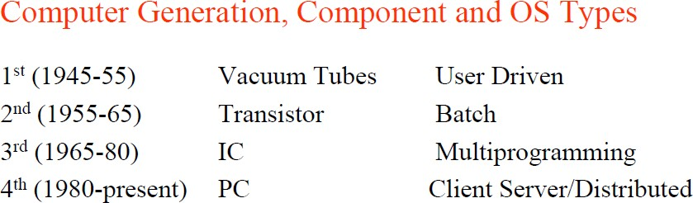
OS Evolution( History)

Slide 17
Batch System
In batch system, operator hired to run computer, the user prepared a job –which consisted of the program, the data, and some control information about the nature of the jobs – and submitted it to the computer operator.
Output appears after some minutes and user collects the outputs from the operator.
Why the name batch system?
Batch: Group of jobs submitted to machine together
Operator collects jobs; orders efficiently; runs one at a time
Here the OS is very simple and its only task is to transfer control from one job to another.

Slide 18
Batch System
The OS is resident on the memory
Operating System (OS)
User program Area

Slide 19
Batch System
Advantages:
Average setup costs over many jobs
Operator more skilled at loading tapes
Keep machine busy while programmer thinks
Problem:
User must wait for results until batch collected and submitted
(If bug receive, memory and register dump; submit job again!)

Slide 20
Multiprogramming operating system (MOS)
A job pool on the disk consist of a number of jobs that are ready to be executed.
Subset of these jobs reside in memory during execution.
OS picks one job ‘x’ and assign it to CPU to executes in memory.
When this job x needs an I/O operation to complete, the CPU is idle.
Now OS switches the CPU to another job (y) to utilize it until the previous job (x) resume (ready) to execute.
As long as there are jobs in memory waiting for CPU, the CPU is never idle.
Choosing one out of several jobs in memory for execution is called CPU scheduling (CPU execute jobs)

Slide 21
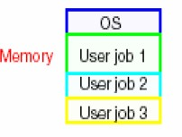
Multiprogramming (MOS)
What is the main function of Multiprogramming OS?
New OS functionality
Job scheduling policies
Memory management and protection (virtual memory)

Slide 22
Timesharing OS
Problem with MOS:
increasing number of users who want to interact with programs while they are running.
humans’ time is expensive don’t want to wait.
Solution
-Timesharing (a variant of Multiprogramming)
The CPU executes multiple jobs by switching among them, but the switches occurs so frequently that the user can interact with each program while it is running.

Slide 23
Time sharing OS (MOS)
It is the logical extension of Multiprogramming
OS provides each user one time slice(slot or share) and each process execute for one time slot in one round.
The CPU switches from one job to another at the end of time slice.
The switching is so fast that the user gets the illusion that the CPU is executing only one user’s job

Slide 24
Timesharing OS(cont…..)
Goal:
Improve user’s response time (interaction)
Advantage:
Users easily submit jobs and get immediate feedback
New OS functionality
More complex job scheduling, memory management
Concurrency control and synchronization

Slide 25
Personal Computers (PC-OS)
The main mode of use of PC is by a single user( as name personal computer).
The System of PC consist of two parts:
BIOS(basic input output system) which is stored in a ROM.
The other part called DOS is stored in a floppy disk or hard disk.
BIOS does what is known is power on self test. Having done this it reads small portion of OS from the disk known as boot portion. Then DOS do all other task such as file management, disk management, CPU management.

Slide 26
Personal Computers (PC-OS)
Dedicated machine per user
CPU utilization is not a prime concern
– Hence, some of the design decision made for advanced system may not be appropriate for these smaller system. But other design decisions, such as those for security, are appropriate because PCs can now be connected to other computer and users through the network and the web.
There are the different types of OS for PC such as Windows, MacOS, UNIX, Linux.

Slide 27
Multiprocessor OS
Most system to date are single-processor system, which will be having only one CPU. However there is a need for multiprocessor system.
A System having more than one processor and all these processor will share the computer bus, the clock and sometime memory, is Multiprocessor OS.

Slide 28
Distributed OS
It is the logical extension of multiprocessor system
In such system, all computation of jobs are distributed among several process.
Here processor don’t share memory and clock. They communicate with one another via communication lines.

Slide 29
Distributed OS
Benefits:
Resource sharing
Computation speedup
Reliability
Communication

Slide 30
Process Management
A process is a program in execution.
For example
A batch job is a process
A time-shared user program is a process
A system task (e.g. spooling output to printer) is a process.
Remember a program itself is not a process rather it is a passive entity.

Slide 31
Process Management
A process needs certain resources, including CPU time, memory, files, and I/O devices, to accomplish its task.
These resources are either given to the process when it is created or when it is running.
When the process completes, the OS reclaims all the resources.
Process manager (OS) handle all these responsibility

Slide 32
Process Management
The operating system is responsible for the following activities in connection with process management.
Process creation and deletion.
Process suspension and resumption.
Provision of mechanisms for:
Process synchronization
Process communication

Slide 33
Memory Management
Memory is a large array of words or bytes, each
with its own address.
It is a repository of quickly accessible data shared by the CPU and I/O devices.
Main memory is a volatile storage device. It loses its contents in the case of system failure.

Slide 34
Memory Management
The operating system is responsible for the following activities in connections with
memory management:
Keep track of which parts of memory are currently being used and by whom.
Decide which processes to load when memory space becomes available.
Allocate and deallocate memory space as needed.

Slide 35
File Management
A file is a collection of related information defined by its creator. Commonly, files represent programs (both source
and object forms) and data.
Most visible component of OS. Computers can store information on several different types of physical media (e.g. magnetic tape, magnetic disk, CD etc).
A file is a logical storage unit, which abstract away the physical properties of its storage device.

Slide 36
File Management
The operating system is responsible for the following activities in connections with file
management:
File creation and deletion.
Directory creation and deletion.
Support of primitives for manipulating files and directories.
Mapping files onto secondary storage.
File backup on stable (nonvolatile) storage media.

Slide 37
I/O Management
All computers have physical devices for acquiring input and producing output.
The I/O system consists of:
A memory management system for buffering and caching system
A general device-driver interface
Drivers for specific hardware devices
Disk management

Slide 38
Secondary Storage Management
The computer system must provide secondary storage to back up main memory since main memory is volatile.
Most modern computer systems use disks as the principle on-line storage medium, for both programs and data.

Slide 39
Secondary Storage Management
The operating system is responsible for the following activities in connection with disk
management:
Free space management
Storage allocation
Disk scheduling

Slide 40
System calls
System calls provide the interface between a process and the operating system.
These calls are generally available as assembly language instructions.
Some systems also allow to make system calls from a high level language, such as C.
Example:
count = read(fd, buffer, nbytes)

Slide 41
Next: Process Management Actual Course Begins Here

